Slide 1
Enabling Remote Worker Productivity with Unified Communications
Presented by:
Adam the Automator

Slide 2
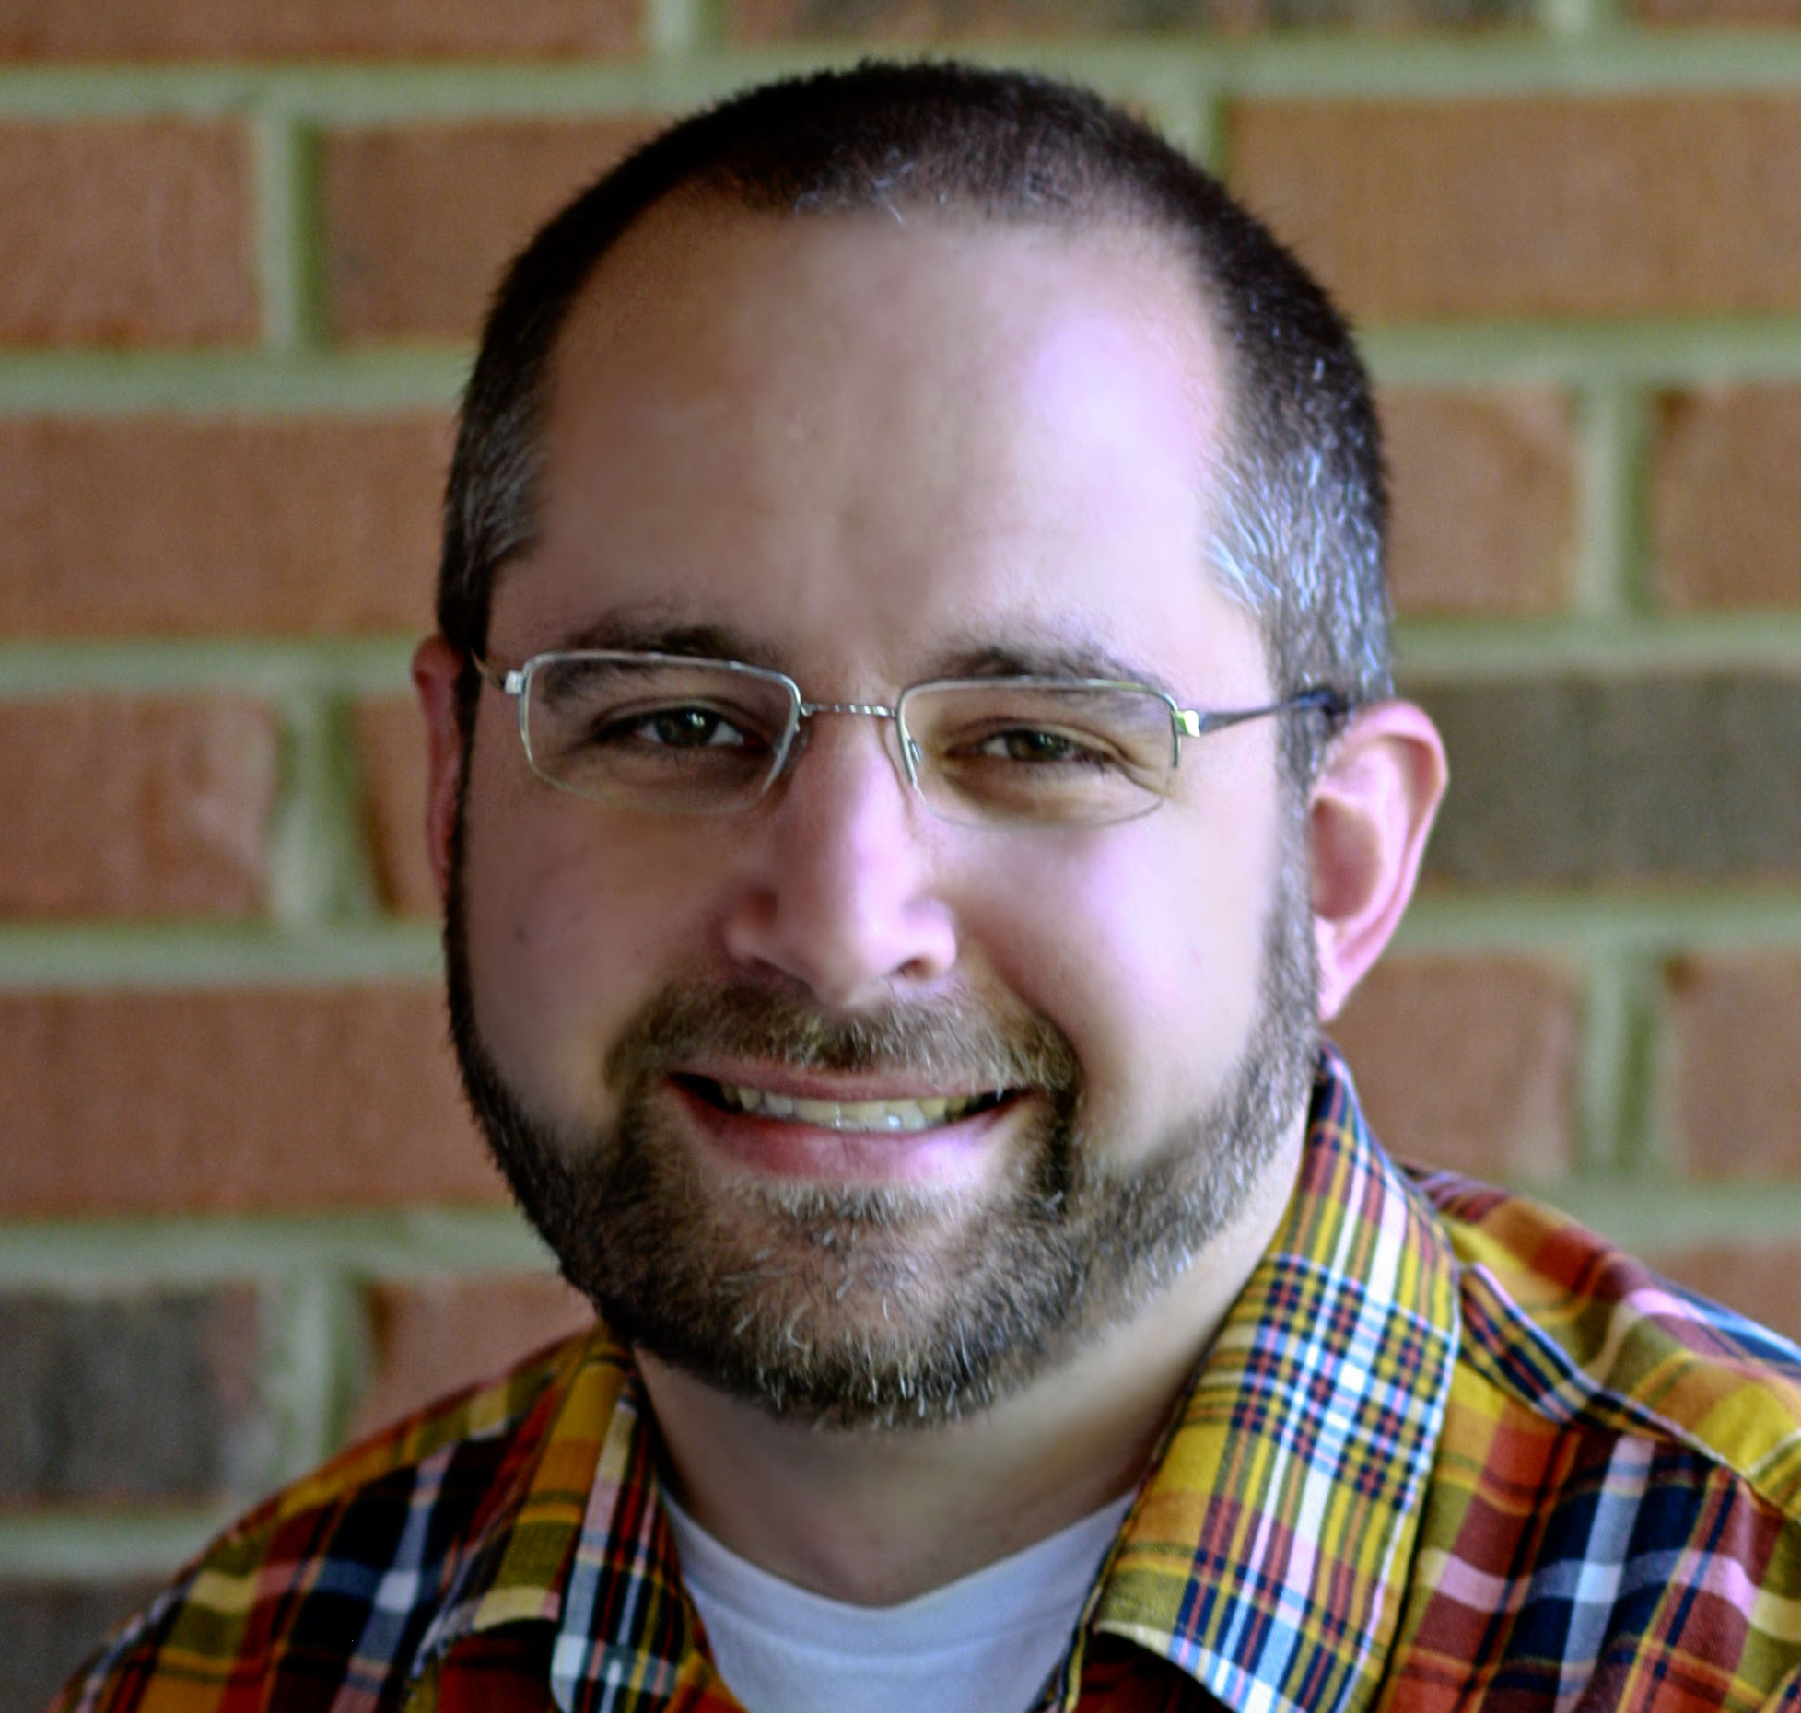
About the Presenter
Pluralsight Author
PowerShell Trainer
Freelance Writer
PowerShell Consultant
Blog: adamtheautomator.com
Twitter: @adbertram
Microsoft Cloud/ Datacenter Management MVP

Slide 3




What Remote Workers Need in a UC System
Mobile
Real-time Communication
Anywhere, Any Time on Any Device
Adaptation to Remote Connectivity

Slide 4
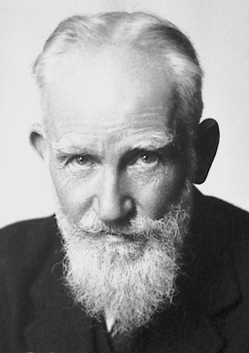
The single biggest problem in communication is the illusion that it has taken place. --George Bernard Shaw

Slide 5

Meet Roger
Road Warrior
Works on Lots of Devices
Constantly Moving

Slide 6


Roger’s Day
Trying to Close a Big Sales Deal
Meeting Planned in Tokyo

Slide 7


2AM - The Late Night Sales Call
Lack of Real-Time Information

Slide 8

6AM - The Failed Voicemail
Failed Messaging
Unknown Server Problems

Slide 9

8:15AM - The Failed Hand-Off
Productivity Hindrance

Slide 10




8:20AM - A Screen Share Gone Bad
Failed Collaboration
Connection Failed

Slide 11

8:30AM - No VMs Today, Weird
0 messages

Slide 12

9AM - Roger's Still on Vacation?
Lack of Real-Time Presence

Slide 13

10AM – Forced to BYOD
Productivity Drain

Slide 14

4:45PM – Old Age Setting In
Lack of a mobile strategy

Slide 15

5PM – The Big Meeting

Slide 16
5:05PM – Uh Oh

Slide 17
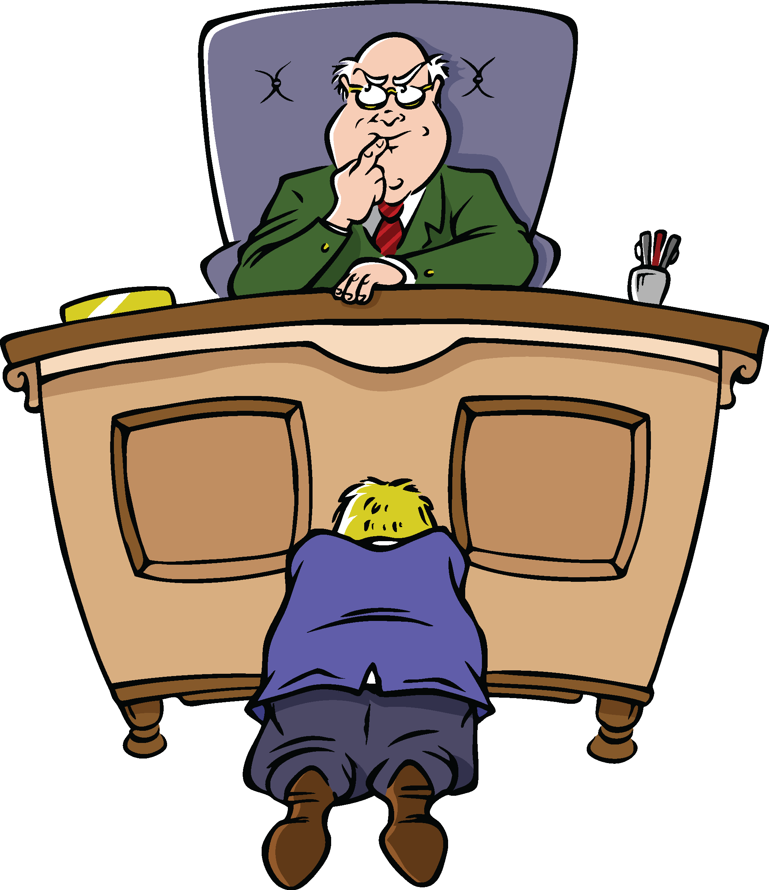
5:15PM – Let the Begging Begin

Slide 18

Next Day – Roger Wisens Up
No more Roger
Soon, no more company

Slide 19
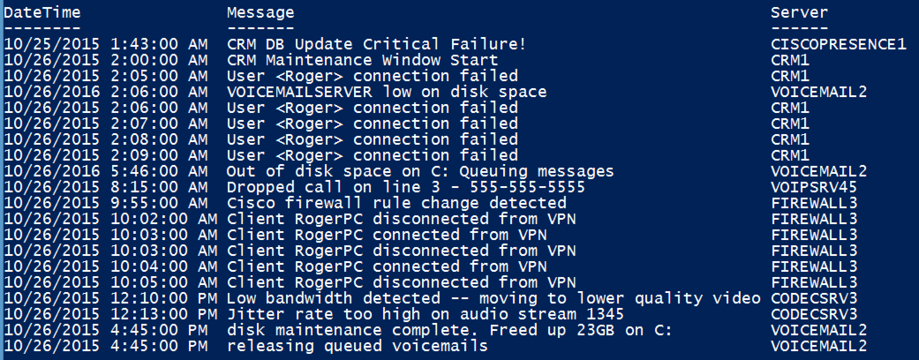
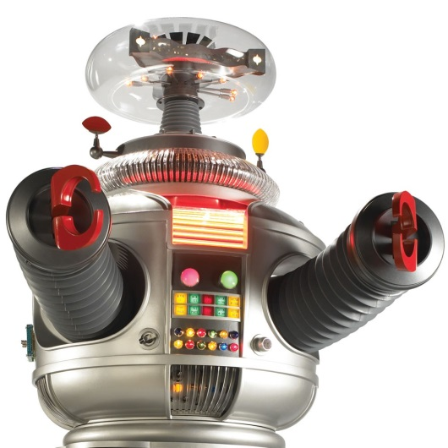
From IT’s Viewpoint
No single point to look
Obscure error messages
Reactive vs. Proactive monitoring
No performance baselines set

Slide 20

BYOD
It must support multiple devices
Work doesn’t happen on one desktop

Slide 21

Mobile Experience is Critical
Account for mobile devices
Monitor the mobile experience

Slide 22
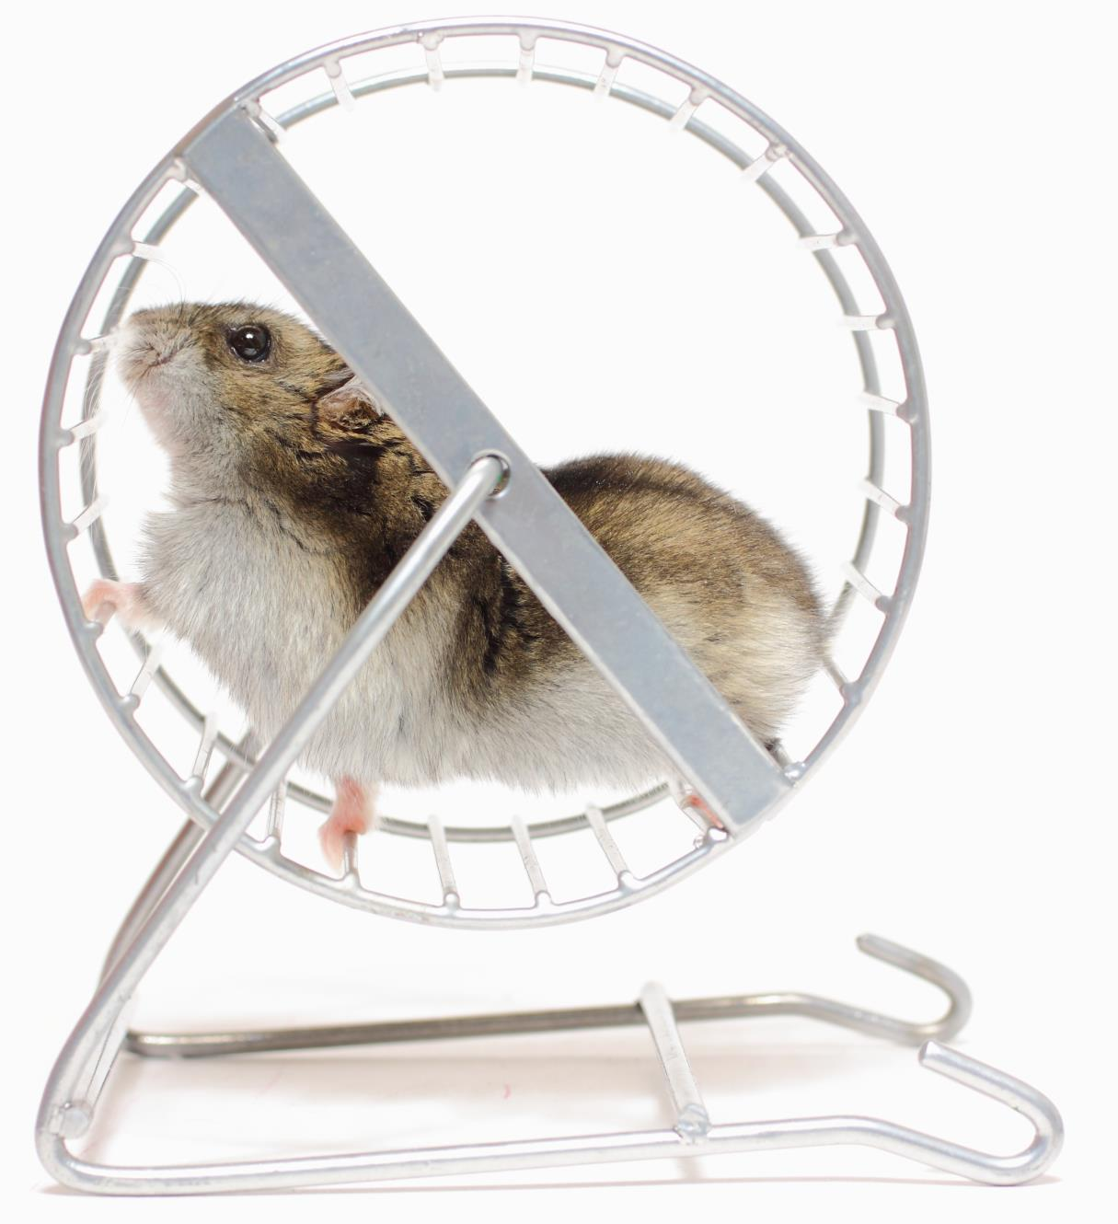
Productivity Never Sleeps
Maintenance windows are old news
Enterprises are 24/7

Slide 23

Keep Up or Get Left Behind
Communication is necessary in real-time
Develop strategies for keeping up

Slide 24
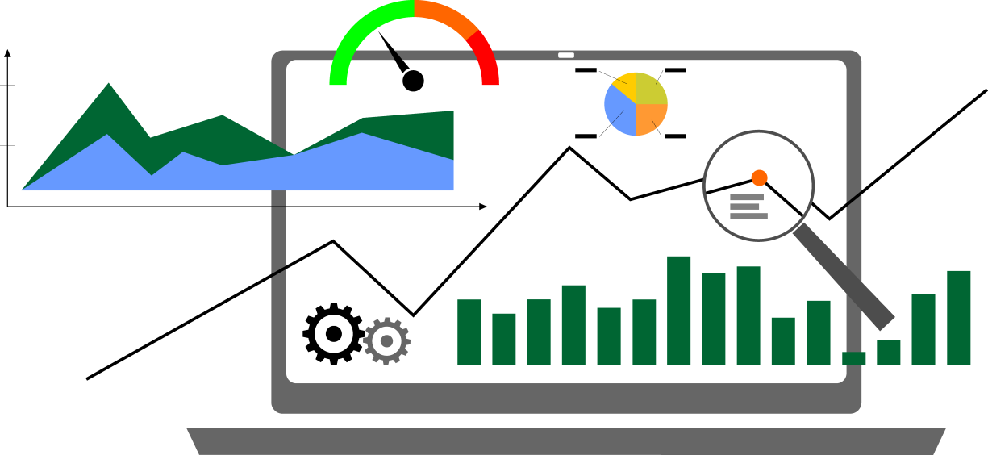
Proactive Monitoring is Crucial
Proactive vs. Reactive
Establish metrics
Define what’s normal
Alerting

Slide 25

Monitoring is Not Problem Resolution
People don’t have time
Ease troubleshooting

Slide 26

Poor Communication is Expensive
$

Slide 27

Meet Bill

